Slide 1
Operating System
Lecture #12
Thread and Thread Scheduling

Slide 2
Objectives
Threads
Types of threads
Process vs thread
User vs Kernel Thread
Thread Scheduling

Slide 3
Threads
A thread is a path of execution within a process. A process can contain multiple threads.
A thread is also known as lightweight process.
The idea is to achieve parallelism by dividing a process into multiple threads.
For example, in a browser, multiple tabs can be different threads. MS Word uses multiple threads: one thread to format the text, another thread to process inputs, etc.

Slide 4
Threads
The primary difference is that threads within the same process run in a shared memory space, while processes run in separate memory spaces.
Threads are not independent of one another like processes are, and as a result threads share with other threads their code section, data section, and OS resources (like open files and signals). But, like process, a thread has its own program counter (PC), register set, and stack space.

Slide 5
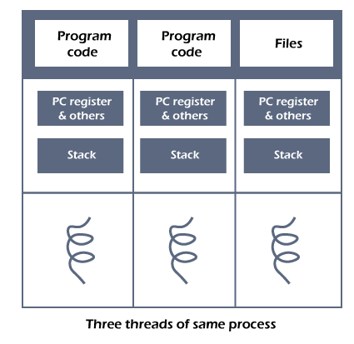

Slide 6
Need of Thread
It takes far less time to create a new thread in an existing process than to create a new process.
Threads can share the common data, they do not need to use Inter- Process communication.
Context switching is faster when working with threads.
It takes less time to terminate a thread than a process.

Slide 7
Types of Threads
In the operating system, there are two types of threads.
Kernel level thread.
User-level thread.

Slide 8
User-level thread
The operating system does not recognize the user-level thread.
User threads can be easily implemented and it is implemented by the user.
If a user performs a user-level thread blocking operation, the whole process is blocked.
The kernel level thread does not know nothing about the user level thread.
The kernel-level thread manages user-level threads as if they are single-threaded processes.

Slide 9
Kernel level thread
The kernel thread recognizes the operating system. There is a thread control block and process control block in the system for each thread and process in the kernel-level thread.
The kernel-level thread is implemented by the operating system. The kernel knows about all the threads and manages them.
The kernel-level thread offers a system call to create and manage the threads from user-space. The implementation of kernel threads is more difficult than the user thread.
Context switch time is longer in the kernel thread.

Slide 10
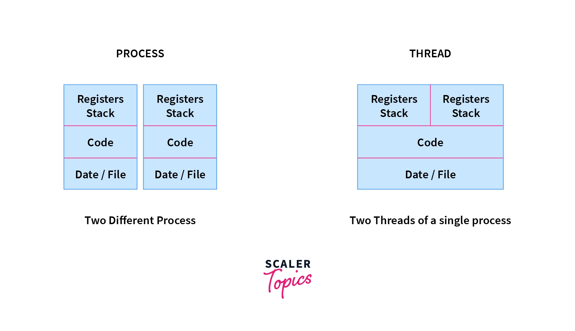
Process vs Thread

Slide 11
Task
Explore the differences of Process and Threads?
Advantages and Disadvantages of User and Kernel level thread.

Slide 12
Process vs Thread
Process | Thread
Processes use more resources and hence they are termed as heavyweight processes. | Threads share resources and hence they are termed as lightweight processes.
Creation and termination times of processes are slower. | Creation and termination times of threads are faster compared to processes.
Processes have their own code and data/file. | Threads share code and data/file within a process.
Communication between processes is slower. | Communication between threads is faster.
Context Switching in processes is slower. | Context switching in threads is faster.
Processes are independent of each other. | Threads, on the other hand, are interdependent. (i.e they can read, write or change another thread’s data)
Eg: Opening two different browsers. | Eg: Opening two tabs in the same browser.

Slide 13
User Level Thread
Advantages of ULT –
Can be implemented on an OS that doesn’t support multithreading.
Simple representation since thread has only program counter, register set, stack space.
Simple to create since no intervention of kernel.
Thread switching is fast since no OS calls need to be made.
Limitations of ULT –
No or less co-ordination among the threads and Kernel.
If one thread causes a page fault, the entire process blocks.

Slide 14
Kernel Level Thread
Advantages of KLT –
Since kernel has full knowledge about the threads in the system, scheduler may decide to give more time to processes having large number of threads.
Good for applications that frequently block.
Limitations of KLT –
Slow and inefficient.
It requires thread control block so it is an overhead.

Slide 15
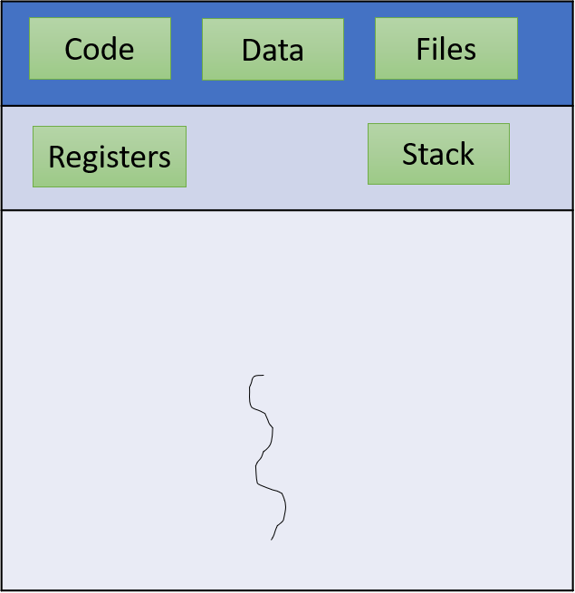
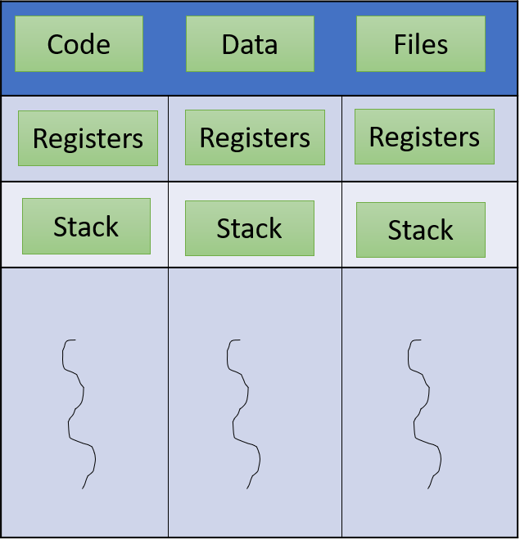
Single Threaded vs Multi Threaded

Slide 16
Many to Many Model
Allows many user-level threads to be mapped to many kernel threads
The many-to-many model multiplexes any number of user threads onto an equal or smaller number of kernel threads.
Allows the operating system to create a sufficient number of kernel threads. The operating system creates a pool of kernel-level threads called the thread-pool. As long as a kernel-level thread is available in the thread-pool it is allocated to a user-level thread.
This model provides the best accuracy on concurrency and when a thread performs a blocking system call, the kernel can schedule another thread for execution.

Slide 17
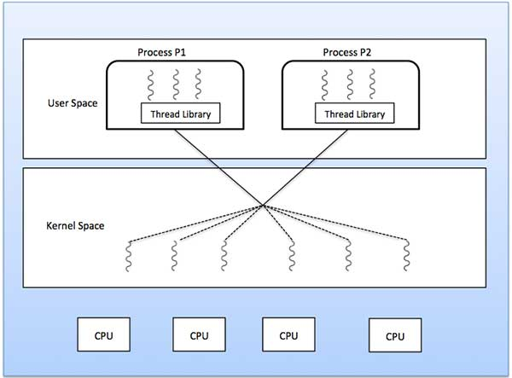

Slide 18
Many to One Model
Many user-level threads mapped to a single kernel thread
Thread management is done in user space by the thread library.
Drawback: The Entire process will block if a thread makes a blocking system call
Only one thread can access the Kernel at a time, so multiple threads are unable to run in parallel on multiprocessors.
If the user-level thread libraries are implemented in the operating system in such a way that the system does not support them, then the Kernel threads use the many-to-one relationship modes.

Slide 19
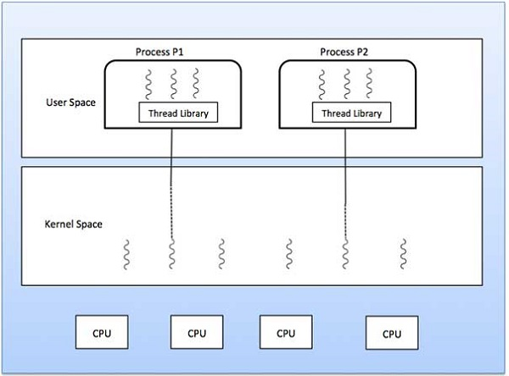

Slide 20
One to One Model
Each user-level thread maps to kernel thread
There is one-to-one relationship of user-level thread to the kernel-level thread. This model provides more concurrency than the many-to-one model.
It also allows another thread to run when a thread makes a blocking system call.
It supports multiple threads to execute in parallel on microprocessors.
Drawback: creating a user thread requires creating a corresponding kernel thread. Since the user can develop a malicious application to create unlimited threads. Therefore, the system too have to create those many kernel-level threads. As a result, the system might slow down.

Slide 21
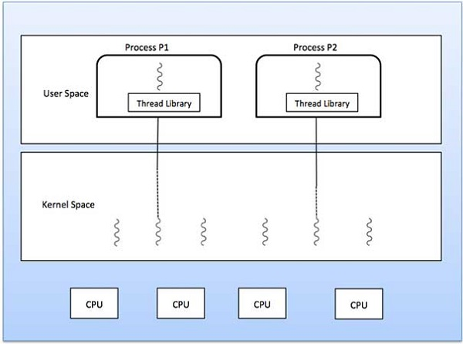

Slide 22
Thread Scheduling
Scheduling of threads involves two boundary scheduling,
Scheduling of user level threads (ULT) to kernel level threads (KLT) via lightweight process (LWP) by the application developer.
Scheduling of kernel level threads by the system scheduler to perform different unique OS functions.

Slide 23
Lightweight Process (LWP)
Light-weight process are threads in the user space that acts as an interface for the ULT to access the physical CPU resources.
Thread library schedules which thread of a process to run on which LWP and how long.
The number of LWP created by the thread library depends on the type of application.

Slide 24
Lightweight Process (LWP)
In the case of an I/O bound application, the number of LWP depends on the number of user-level threads.
This is because when an LWP is blocked on an I/O operation, then to invoke the other ULT the thread library needs to create and schedule another LWP.
Thus, in an I/O bound application, the number of LWP is equal to the number of the ULT.
In the case of a CPU bound application, it depends only on the application. Each LWP is attached to a separate kernel-level thread.

Slide 25
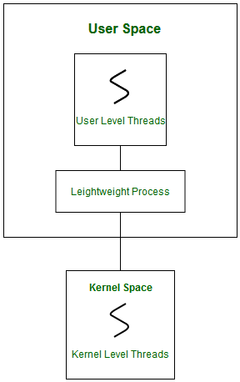
Lightweight Process (LWP)

Slide 26
Thread Scheduling
In real-time, the first boundary of thread scheduling is beyond specifying the scheduling policy and the priority.
It requires two controls to be specified for the User level threads:
Contention scope,
Allocation domain.

Slide 27
Contention Scope
The word contention here refers to the competition or fight among the User level threads to access the kernel resources.
Thus, this control defines the extent to which contention takes place.
It is defined by the application developer using the thread library.
Depending upon the extent of contention it is classified as
Process Contention Scope
System Contention Scope.

Slide 28
Process Contention Scope (PCS)
The contention takes place among threads within a same process.
The thread library schedules the high-prioritized PCS thread to access the resources via available LWPs.
Priority as specified by the application developer during thread creation.

Slide 29
System Contention Scope (SCS)
The contention takes place among all threads in the system. In this case, every SCS thread is associated to each LWP by the thread library and are scheduled by the system scheduler to access the kernel resources.
In LINUX and UNIX operating systems, the POSIX Pthread library provides a function Pthread_attr_setscope to define the type of contention scope for a thread during its creation.

Slide 30
Allocation Domain
The allocation domain is a set of one or more resources for which a thread is competing.
In a multicore system, there may be one or more allocation domains where each consists of one or more cores.
One ULT can be a part of one or more allocation domain. Due to this high complexity in dealing with hardware and software architectural interfaces, this control is not specified.
But by default, the multicore system will have an interface that affects the allocation domain of a thread.

Slide 31
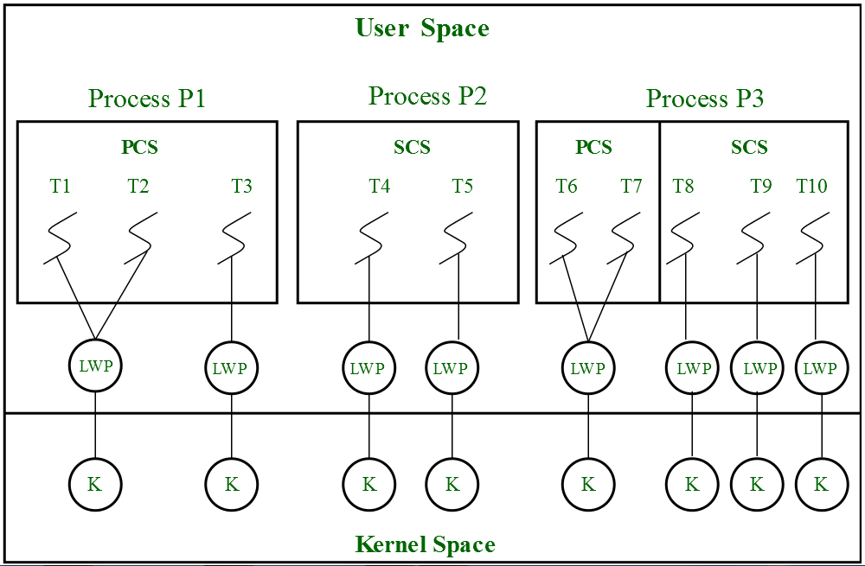
Consider a scenario, an operating system with three process P1, P2, P3 and 10 user level threads (T1 to T10) with a single allocation domain. 100% of CPU resources will be distributed among all the three processes. The amount of CPU resources allocated to each process and to each thread depends on the contention scope, scheduling policy and priority of each thread defined by the application developer using thread library and also depends on the system scheduler. These User level threads are of a different contention scope.

Slide 32
Formulas to calculate LWPs
Number of Kernel Level Threads = Total Number of LWP
Total Number of LWP = Number of LWP for SCS + Number of LWP for PCS
Number of LWP for SCS = Number of SCS threads
Number of LWP for PCS = Depends on application developer

Slide 33
Number of SCS threads = ? Number of LWP for PCS = ?
Number of SCS threads = ? Number of LWP for SCS = ?
Total Number of LWP = ? Number of Kernel Level Threads = ?

Slide 34
Any Query??

